Slide 1
Identify the Influential Spreaders in Social Networks
Xiaotong Diao
Ziyuan Dong
12.7.2018

Slide 2
Motivation
Selecting individuals with the most potential influence in a large-scale complex networks can help us control the spreading process

Slide 3
Our Work
Use improved SIR model to test 9 methods related to identifying influential spreaders
Degree Distance
Single Discount / Degree Discount
Generalized Degree Discount
Degree / Betweenness / Closeness centrality
Pagerank
Coreness centrality

Slide 4
Dataset: Gnutella Peer-to-peer Network
Gnutella peer-to-peer file sharing network, August 2002
Network statistics
nodes | 6301
edgs | 20777
average clustering coefficient | 0.0109
diameter | 9
is weighted | No
is directed | No
Reference: Leskovec, Jure and Kleinberg, Jon and Faloutsos, Christos SNAP Datasets: Stanford Large Network Dataset Collection, http://snap.stanford.edu/data, (2014)

Slide 5
Improved SIR Model
Each infected node only transmit the “virus” to one of its neighbors at a time with probability p

Slide 6
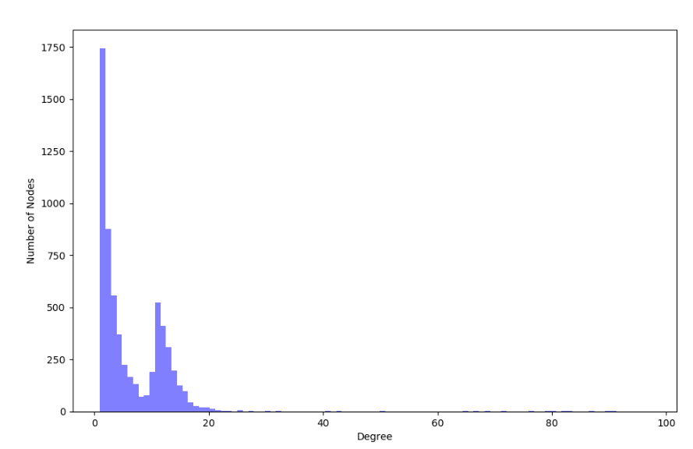
Social Networks is Scale-free
You can copy&paste graphs from Google Sheets

Slide 7
Improved SIR Model
Each infected node only transmit the “virus” to one of its neighbors at a time with probability p
Then this infected node (state “I”) will recover (state “R”) with probability q
The simulation will end when no infected node remains

Slide 8

How to Measure Influence
R: the number of nodes that has been recovered in the spreading process
N: the total number of nodes in the network.
Influence = $\frac{R}{N}$

Slide 9
Intuition and problems
Nodes with higher degree are more influential
It isn’t always true
If u is already a spreader:
v doesn’t need to infect u in return
u may infect v with some probability later
u weakens the potential influence of its neighbours
u
v

Slide 10
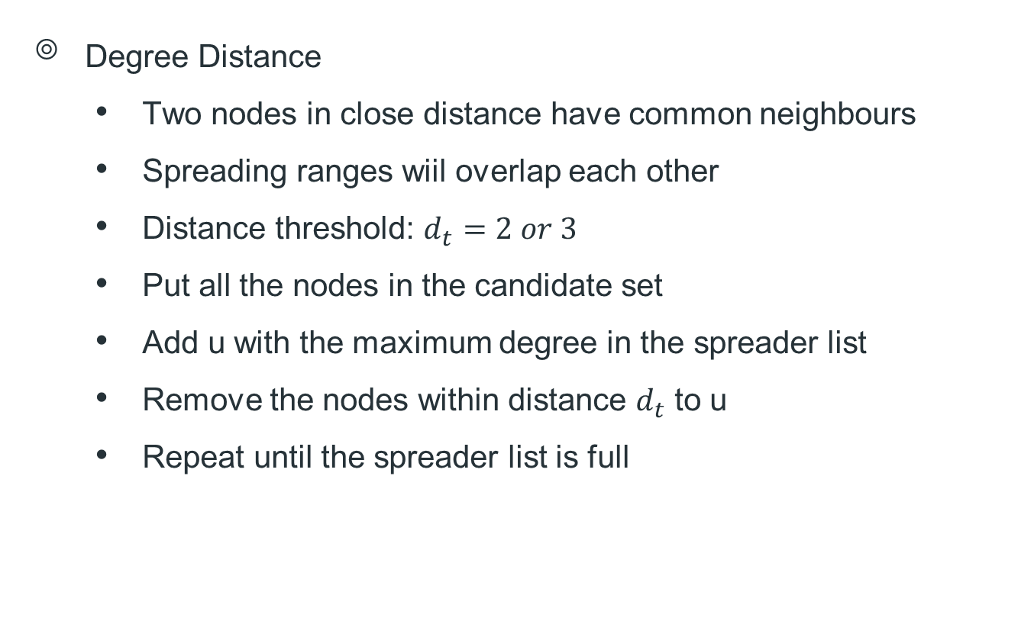
Degree-based heuristics
Degree Distance
Two nodes in close distance have common neighbours
Spreading ranges wiil overlap each other
Distance threshold: $d_{t}=2 or 3$
Put all the nodes in the candidate set
Add u with the maximum degree in the spreader list
Remove the nodes within distance $d_{t}$ to u
Repeat until the spreader list is full
u
v

Slide 11
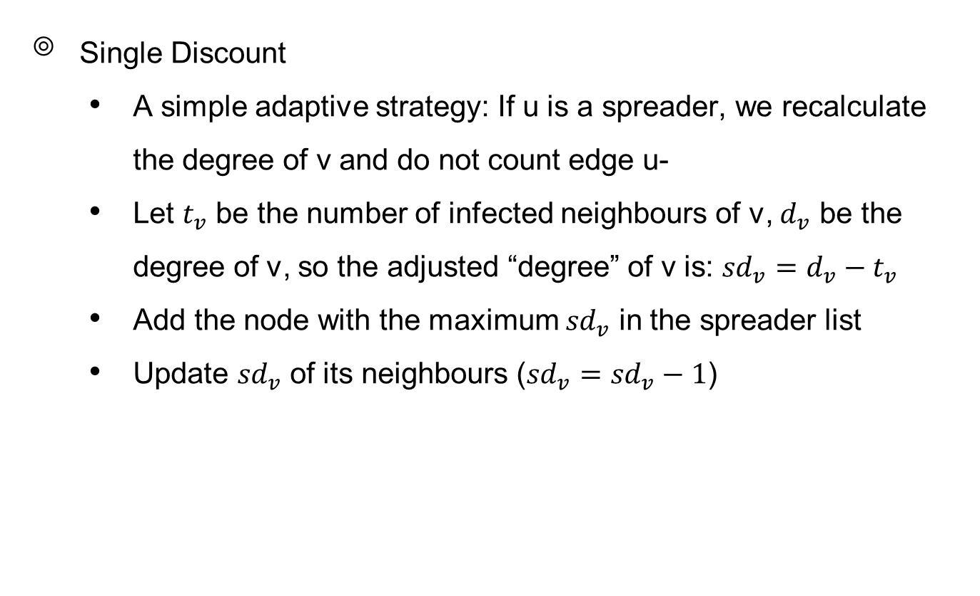
Degree-based heuristics
Single Discount
A simple adaptive strategy: If u is a spreader, we recalculate the degree of v and do not count edge u-
Let $t_{v}$ be the number of infected neighbours of v, $d_{v}$ be the degree of v, so the adjusted “degree” of v is: ${sd}_{v}={d_{v}−t}_{v}$
Add the node with the maximum ${sd}_{v}$ in the spreader list
Update ${sd}_{v}$ of its neighbours (${sd}_{v}={sd}_{v}−1$)
v
u

Slide 12
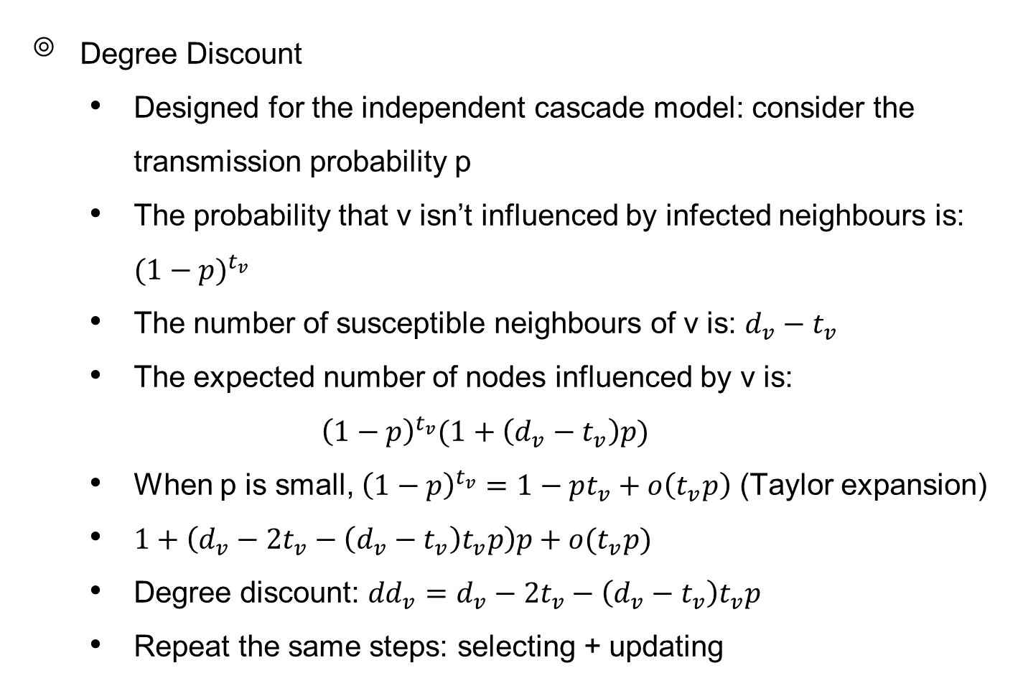
Degree-based heuristics
Degree Discount
Designed for the independent cascade model: consider the transmission probability p
The probability that v isn’t influenced by infected neighbours is: ${(1−p)}^{t_{v}}$
The number of susceptible neighbours of v is: ${d_{v}−t}_{v}$
The expected number of nodes influenced by v is:
$${\left(1−p\right)}^{t_{v}}(1+\left(d_{v}−t_{v}\right)p)$$
When p is small, ${\left(1−p\right)}^{t_{v}}=1−pt_{v}+o\left(t_{v}p\right)$ (Taylor expansion)
$1+\left(d_{v}−2t_{v}−\left(d_{v}−t_{v}\right)t_{v}p\right)p+$ $o(t_{v}p)$
Degree discount: ${dd}_{v}=d_{v}−2t_{v}−\left(d_{v}−t_{v}\right)t_{v}p$
Repeat the same steps: selecting + updating

Slide 13
v

Slide 14
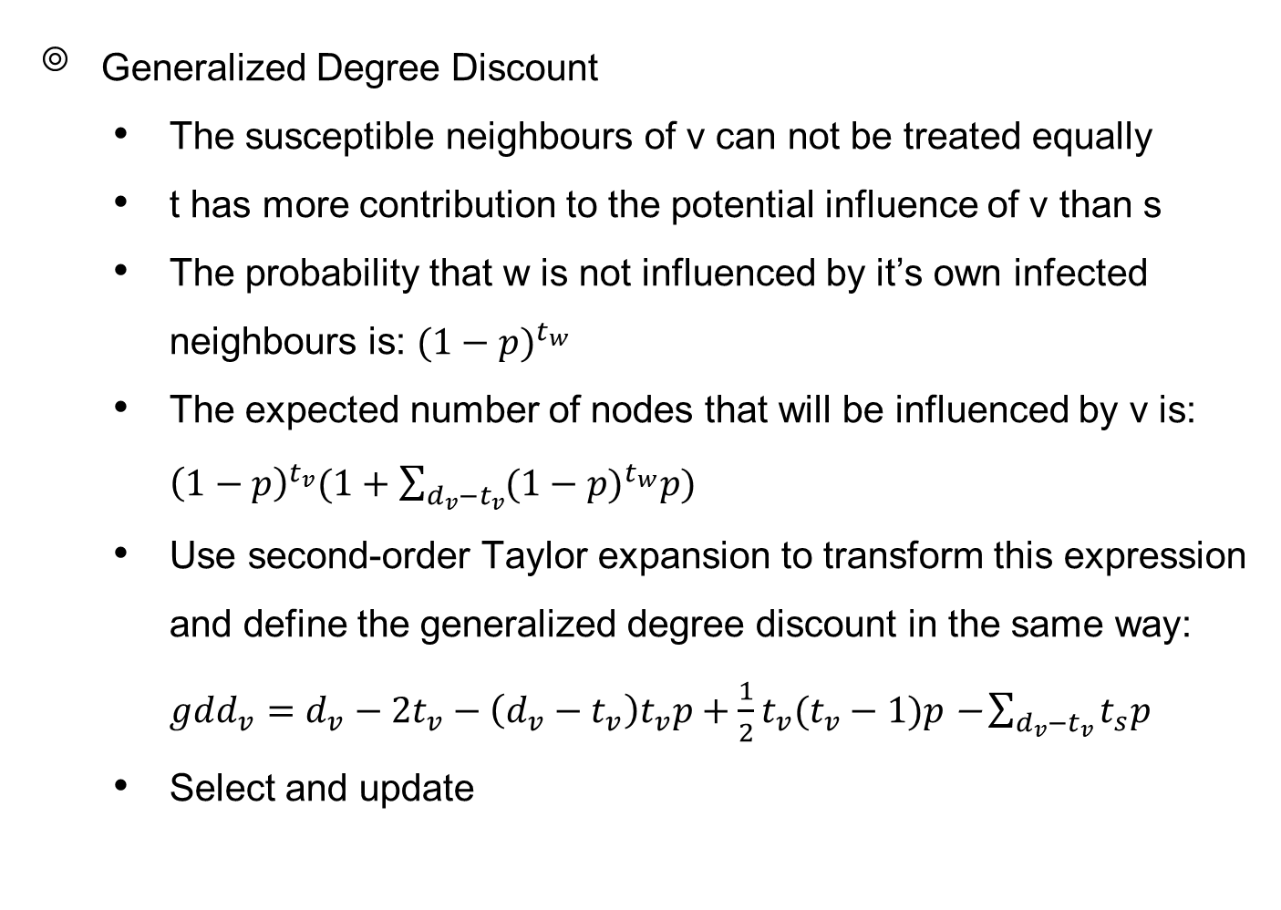
Degree-based heuristics
Generalized Degree Discount
The susceptible neighbours of v can not be treated equally
t has more contribution to the potential influence of v than s
The probability that w is not influenced by it’s own infected neighbours is: ${(1−p)}^{t_{w}}$
The expected number of nodes that will be influenced by v is: ${\left(1−p\right)}^{t_{v}}(1+\sum_{d_{v}−t_{v}}{{(1−p)}^{t_{w}}p})$
Use second-order Taylor expansion to transform this expression and define the generalized degree discount in the same way:
${gdd_{v}=d}_{v}−2t_{v}−\left(d_{v}−t_{v}\right)t_{v}p+\frac{1}{2}t_{v}(t_{v}−1)p\text{ −}\sum_{d_{v}−t_{v}}{t_{s}p}$
Select and update

Slide 15
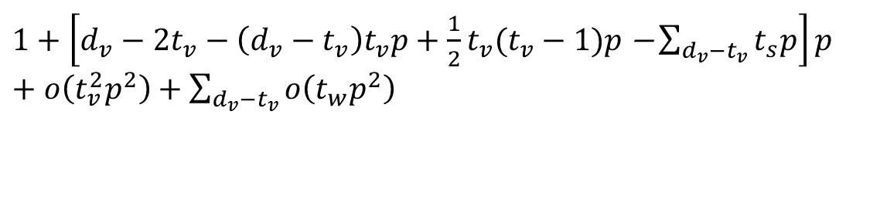
s
v
t
$1+\left[d_{v}−2t_{v}−\left(d_{v}−t_{v}\right)t_{v}p+\frac{1}{2}t_{v}(t_{v}−1)p\text{ −}\sum_{d_{v}−t_{v}}{t_{s}p}\right]p$ $+o\left(t_{v}^{2}p^{2}\right)+$ $\sum_{d_{v}−t_{v}}{o\left(t_{w}p^{2}\right)}$

Slide 16
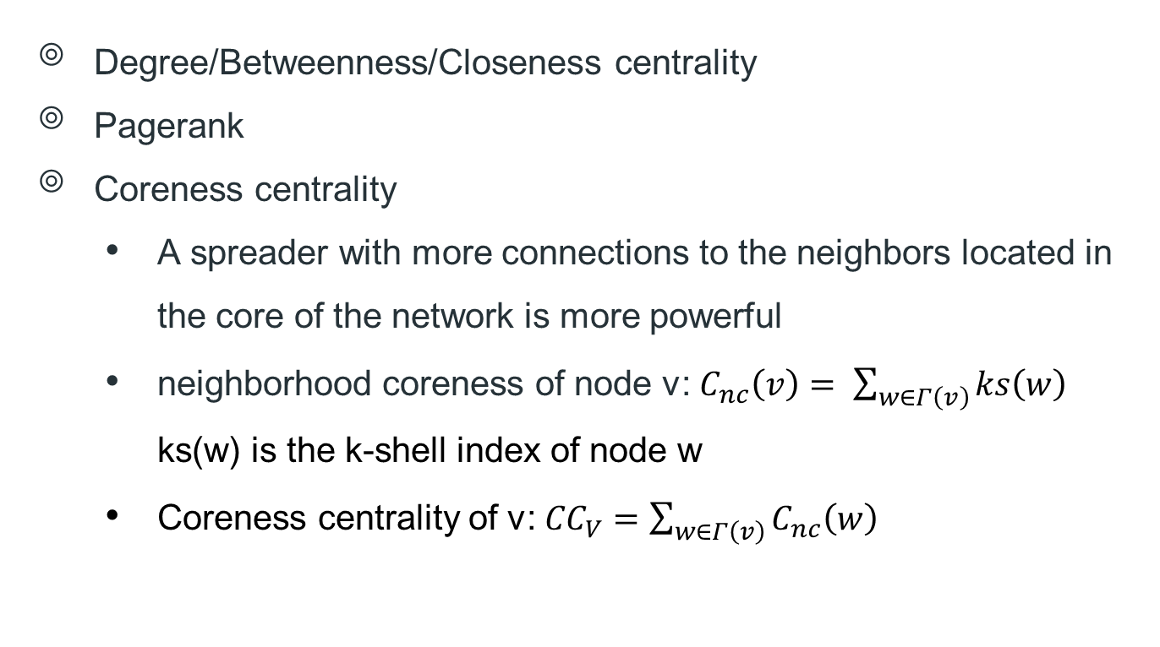
Benchmark methods
Degree/Betweenness/Closeness centrality
Pagerank
Coreness centrality
A spreader with more connections to the neighbors located in the core of the network is more powerful
neighborhood coreness of node v: $C_{nc}\left(v\right)= \sum_{w∈Γ\left(v\right)}{ks\left(w\right)}$
ks(w) is the k-shell index of node w
Coreness centrality of v: ${CC}_{V}=\sum_{w∈Γ\left(v\right)}{C_{nc}\left(w\right)}$

Slide 17
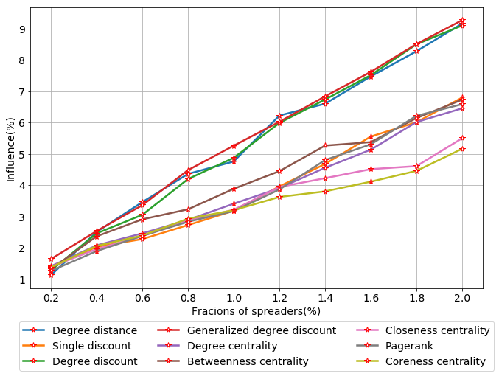
Simulation results

Slide 18
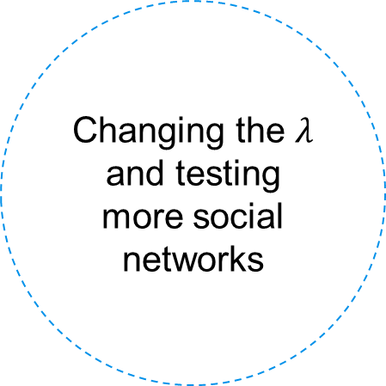
Future work
Changing the $λ$ and testing more social networks
Adjusting
p based-on
closeness
Adding weight based-on the importance of each node

Slide 19
Thank you !

